Slide 1
Detection of Dental Diseases Using Convolutional Neural Networks (CNN)
A Deep Learning Approach for Dental Radiograph Analysis
DEEPIKA KASTURI 23098127

Slide 2
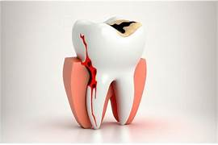
Introduction
Dental diseases are common and require early diagnosis.
Traditional diagnosis depends on dentist expertise and visual inspection.
Deep Learning, especially CNN, can automatically detect dental issues using X-ray images.
This project aims to build a CNN model that identifies dental diseases from radiographic images.

Slide 3
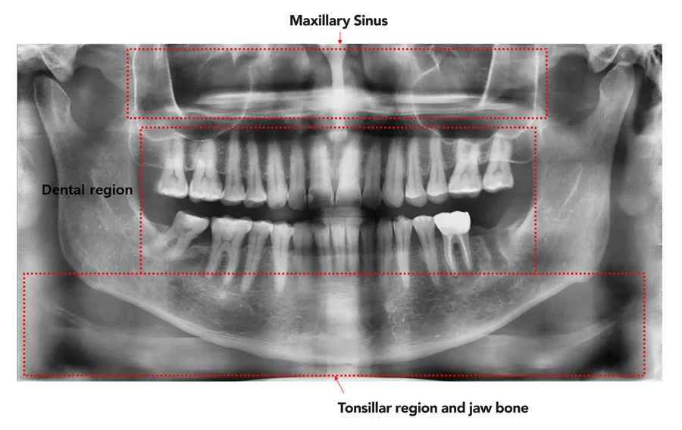
Problem Statement
Manual dental diagnosis is time-consuming, subjective, and error-prone.
Large number of patients → difficult for dentists to inspect each image accurately.
Need for an automated, fast, and reliable system to support dentists.
Goal: Build a CNN-based model for accurate detection of dental diseases.

Slide 4
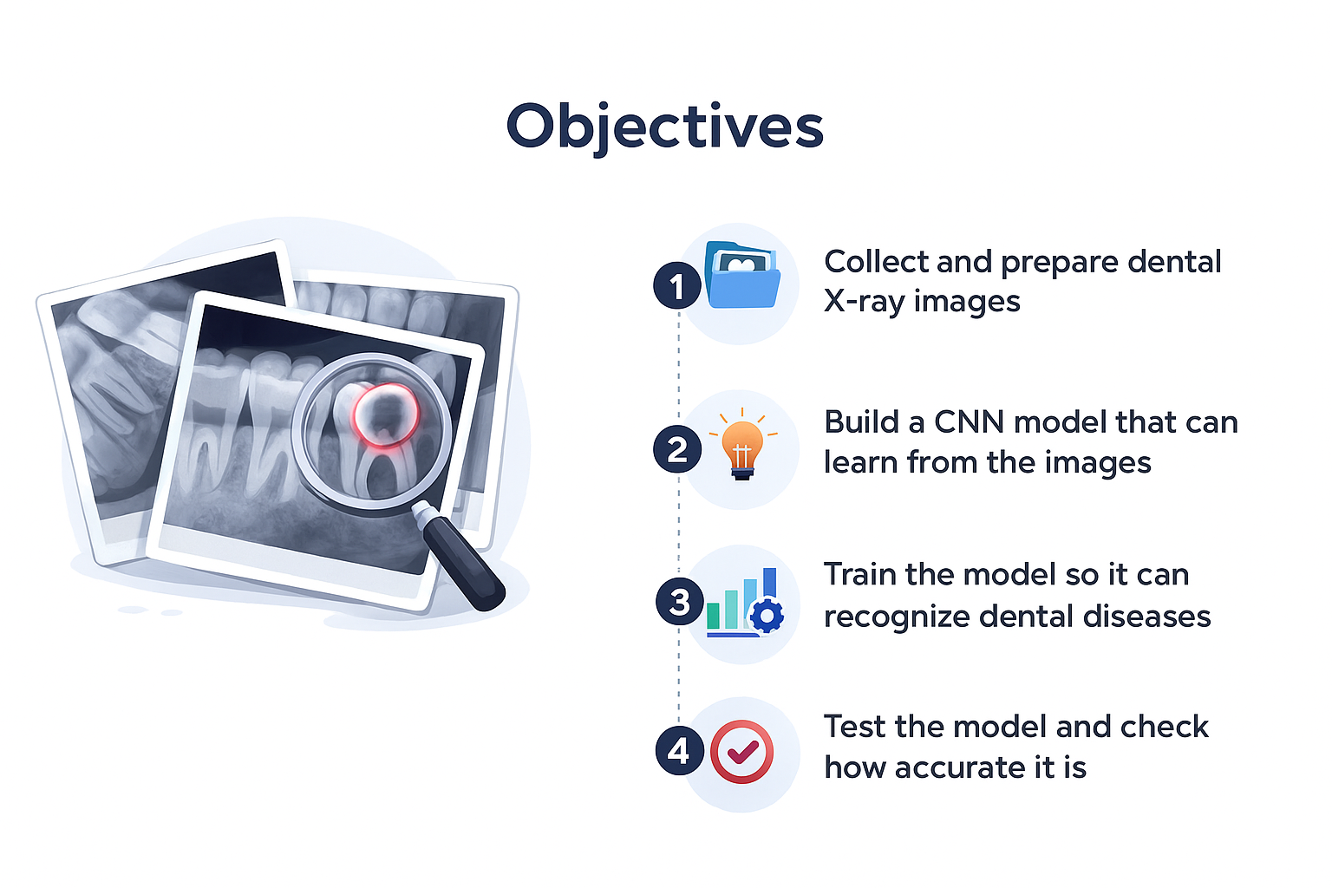

Slide 5
Dataset Description
The dataset contains dental X-ray images collected from different patients.
It includes images of healthy teeth and various dental diseases such as cavities, gum disease, and root problems.
Images come in different sizes and qualities, so preprocessing is needed.
The dataset is divided into training, validation, and testing sets to train the CNN properly.
Data augmentation is used to create more image variations and improve model accuracy.

Slide 6
Data Preprocessing
🔹 Resize Images
All images are converted to the same size (e.g., 224×224).
Helps CNN read images properly.
🔹 Normalize Pixels
Convert pixel values from 0–255 → 0–1.
Makes training faster and smoother.
🔹 Data Augmentation
Create extra image variations:
Rotation
Flipping
Zooming
Helps increase dataset size and avoid overfitting.
🔹 Split the Dataset
Training Set – used to teach the model
Validation Set – used during training to tune model
Test Set – used to check final accuracy

Slide 7
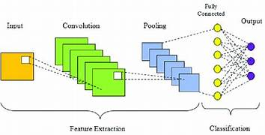
CNN Architecture Overview
Input Layer (224×224 image).
Convolutional Layers → feature extraction.
ReLU activation.
Max Pooling Layers → reduces spatial size.
Flatten Layer → converts to 1D.
Dense Layers → classification.
Softmax Output → multi-class prediction.

Slide 8

Advantages of Using CNN
High accuracy in detection
Reduces human error
Faster analysis of large datasets
Can assist dentists in decision-making

Slide 9
Model Flowchart
Input Preprocessing CNN Model Training
Output Prediction Evaluation

Slide 10
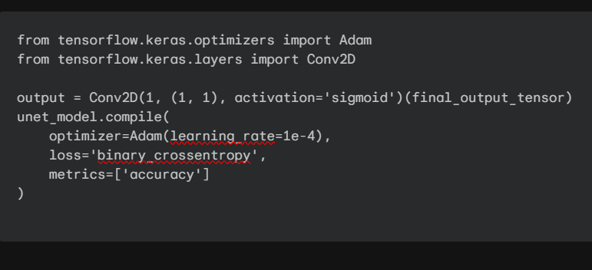
Model Implementation & Training Parameters
1. Stage 1: U-Net for Semantic Segmentation
(U-Net): Focusing on precision for clinical/diagnostic monitoring.
The U-Net model is configured for Semantic Segmentation, focusing on pixel-level accuracy.

Slide 11
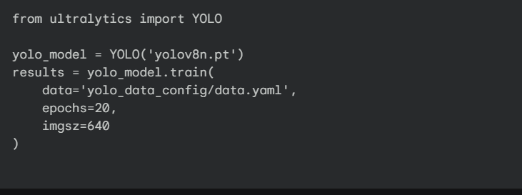
Theme 2 (YOLOv8): Focusing on speed for mass screening/triage.
YOLOv8 is an extremely fast, state-of-the-art CNN for Object Detection, quickly drawing a simple bounding box around the lesion.
Its primary role in your hybrid system is to rapidly find the Region of Interest (ROI), prioritizing speed before the final U-Net refinement.

Slide 12
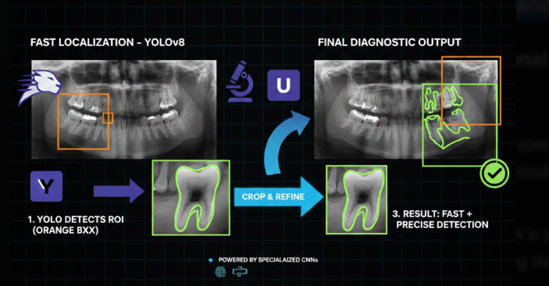
U-Net and YOLO in Collaboration
YOLO is the fast "Speed CNN" for initial bounding box localization, and U-Net is the highly precise "Precision CNN" for pixel-level segmentation. This hybrid process uses the fast CNN's output to focus the precise CNN, ensuring an optimized blend of speed and diagnostic accuracy.

Slide 13
Conclusion
CNNs significantly improve dental disease detection.
Effective in identifying abnormalities from radiographic images.
Future work:
Improve dataset size
Use transfer learning (e.g., VGG16, ResNet)
Deploy as a clinical decision-support tool

Slide 14


